Slide 2
How Earthquake-Proof Buildings Are Designed

Slide 3
Earthquakes are one of the Earth’s most destructive forces — the seismic waves throughout the ground can destroy buildings, take lives, and costs tremendous amounts of money for loss and repair.
According to the National Earthquake Information Center, there is an average of 20,000 earthquakes each year —16 of them being major disasters. On September 20, 2017, a magnitude 7.1 rocked Mexico’s capital city and killed approximately 230 people.
As with the case with other earthquakes, the damage was not caused by the quake itself but by the collapse of buildings with people inside them, making earthquake-proof buildings a must.
Over the past few decades, engineers have introduced new designs and building materials to better equip buildings to withstand earthquakes.

Slide 4
How Earthquakes Impact Buildings

Slide 5
It is important to understand how earthquakes impact man-made structures.
When an earthquake occurs, it sends shockwaves throughout the ground in short rapid intervals in all different directions.
While buildings are generally equipped to handle vertical forces from their weight and gravity, they cannot handle side-to-side forces emitted by quakes.
This horizontal load vibrates walls, floors, columns, beams and the connectors that hold them together.
The difference in movement between the bottom and top of buildings exerts extreme stress, causing the supporting frame to rupture and the entire structure to collapse.

Slide 6

How to Make A Building Earthquake-Proof
To design an earthquake-proof building, engineers need to reinforce the structure and counteract an earthquake’s forces.
Since earthquakes release energy that pushes on a building from one direction, the strategy is to have the building push the opposite way. Here are some of the methods used to help buildings withstand earthquakes.
Create a Flexible Foundation

Slide 7
One way to resist ground forces is to “lift” the building’s foundation above the earth. Base isolation involves constructing a building on top of flexible pads made of steel, rubber, and lead.
When the base moves during the earthquake, the isolators vibrate while the structure itself remains steady. This effectively helps to absorb seismic waves and prevent them from traveling through a building.

Slide 8

2. Counter Forces with Damping
We are aware of that cars have shock absorbers. However, engineers also use them for making earthquake-resistant buildings.
Similar to their use in cars, shock absorbers reduce the magnitude of shockwaves and help buildings slow down.
This is accomplished in two ways: vibrational control devices and pendulum dampers.
Vibrational Control Devices

Slide 9

The first method involves placing dampers at each level of a building between a column and beam.
Each damper consists of piston heads inside a cylinder filled with silicone oil.
When an earthquake occurs, the building transfers the vibration energy into the pistons, pushes against the oil.
The energy is transformed into heat, dissipating the force of the vibrations.
Pendulum Power

Slide 10
Another damping method is pendulum power, used primarily in skyscrapers. Engineers suspend a large ball with steel cables with a system of hydraulics at the top of the building.
When the building begins the sway, the ball acts as a pendulum and moves in the opposite direction to stabilize the direction.
Like damping, these features are tuned to match and counteract the building’s frequency in the event of an earthquake.
3. Shield Buildings from Vibrations

Slide 11
Instead of just counteracting forces, researchers are experimenting with ways buildings can deflect and reroute the energy from earthquakes altogether.
Dubbed the “seismic invisibility cloak”, this innovation involves creating a cloak of 100 concentric plastic and concrete rings in and burying it at least three feet beneath the foundation of the building.
As seismic waves enter the rings, they are forced to move through to the outer rings for easier travel. As a result, they are essentially channeled away from the building and dissipated into the plates in the ground.
4. Reinforce the Building’s Structure
To withstand collapse, buildings need to redistribute the forces that travel through them during a seismic event. Shear walls, cross braces, diaphragms, and moment-resisting frames are central to reinforcing a building.

Slide 12
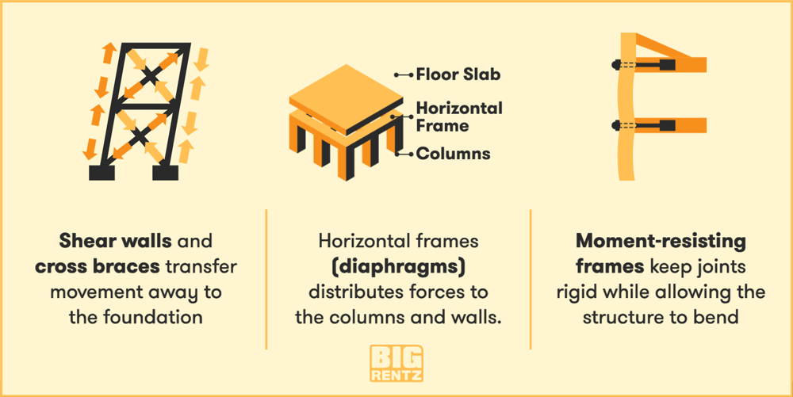
Shear walls are a useful building technology that helps to transfer earthquake forces.
Made of panels, these walls help a building keep its shape during movement. Shear walls are often supported by diagonal cross braces.
These steel beams have the ability to support compression and tension, which helps to counteract the pressure and push forces back to the foundation.

Slide 13
Diaphragms are a central part of a building’s structure. Consisting of the floors of the building, the roof, and the decks placed over them, diaphragms help remove tension from the floor and push force to the vertical structures of the building.
Moment-resisting frames provide more flexibility in a building’s design. This structure is placed among the joints of the building and allows for the columns and beams to bend while the joints remain rigid.
Thus, the building is able to resist the larger forces of an earthquake while allowing designers more freedom to arrange building elements.
Earthquake-Resistant Materials
Steel and Wood
For a building material to resist stress and vibration, it must have high ductility — the ability to undergo large deformations and tension.
Modern buildings are often constructed with structural steel — a component of steel that comes in a variety of shapes that allow buildings to bend without breaking.
Wood is also a surprising ductile material due to its high strength relative to its lightweight structure.

Slide 15
Innovative Materials
Scientists and engineers are developing new building materials with even greater shape retention. Innovations like shape memory alloys have the ability to both endure heavy strain and revert to their original shape, while fiber-reinforced plastic wrap — made by a variety of polymers — can be wrapped around columns and provide up to 38% greater strength and ductility.
Engineers are also turning to natural elements. The sticky yet rigid fibers of mussels and the strength-to-size ratio of spider silk have promising capabilities in creating structures. Bamboo and 3D printed materials can also function as lightweight, interlocking structures with limitless forms that can potentially provide even greater resistance for buildings.

Slide 16
Over the years, engineers and scientists have devised techniques to create some effective earthquake-proof buildings. As advanced the technology and materials are today, it is not yet possible for building to completely withstand a powerful earthquake unscathed. Still, if a building is able to allow its occupants to escape without collapsing and saves lives and communities, we can consider that a great success.
Sources: How Stuff Works 1, 2 | REIDsteel | Rishabh Engineering | Seeker | Futurism | VIATechnik | Interesting Engineering | Architizer | kcFED | National Geographic
Construction

